Slide 1
Final Project Proposal
Final Project Proposal
Jessica Brown
Jessica Brown

Slide 2
IDEA
IDEA
Recognize Zumba Moves with IMU data and machine learning
Record each move individually to train models
Create dance routines & try to distinguish the individual moves in a routine

Slide 3
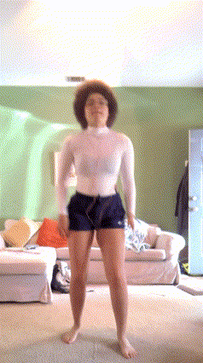
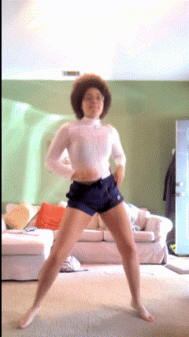
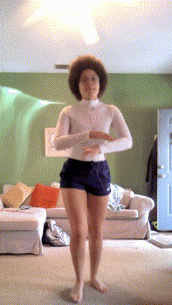
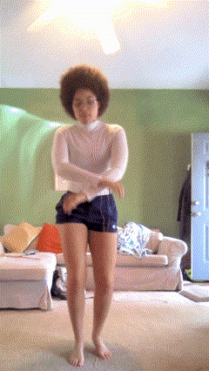
Dance Move Examples
Dance Move Examples
Already identified 20 moves, but I can think of more, so I may reduce or change them
Vs.
Vs.

Slide 4
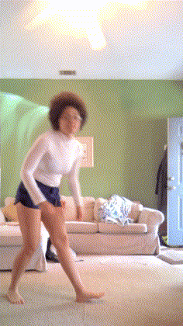
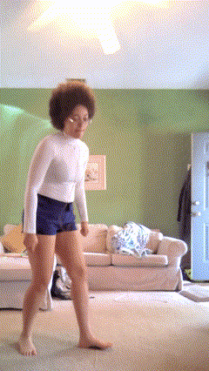
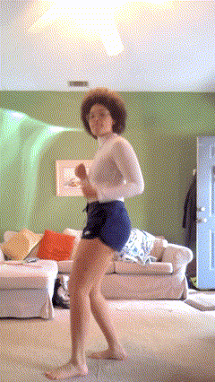
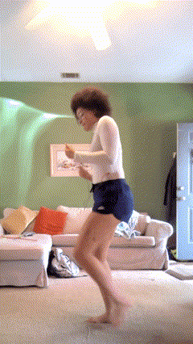
Vs.
Vs.

Slide 5
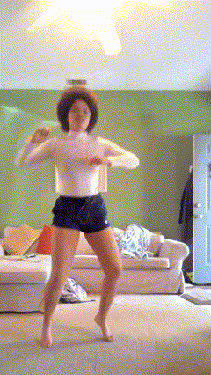
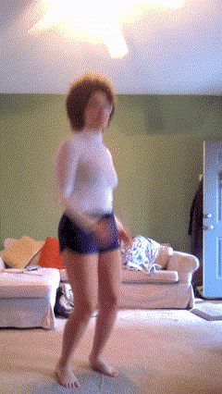
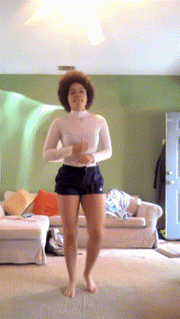
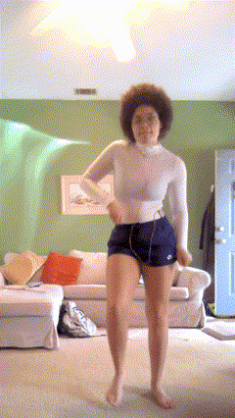
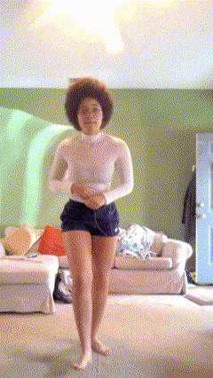
AND MANY MORE…
AND MANY MORE…

Slide 6
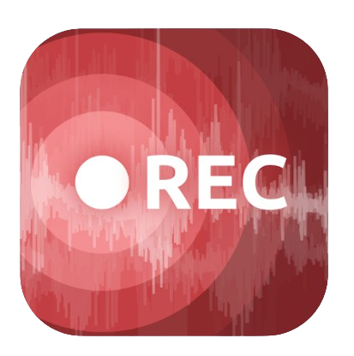
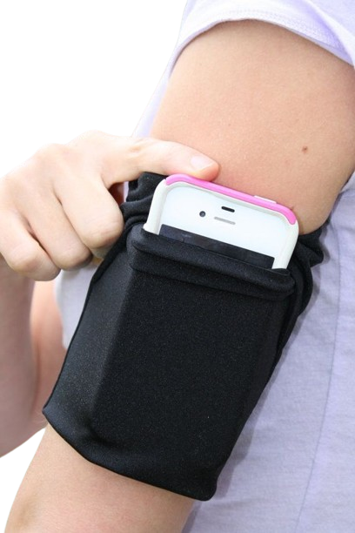
How Will I Gather Data?
How Will I Gather Data?
Use Sensor Logger App to gather IMU data
IMU: Accelerometer, Gyroscope, and Magnetometer
Place phone on arm (location)?
Record with video so I can split and identify timestamps of dance moves in the data

Slide 7
What Type of Algorithms?
What Type of Algorithms?
Looking For: time-series and recognizing patterns
Recurrent Neural Networks (RNN)
K-Nearest Neighbors (KNN)
Hidden Markov Models (HMM)
Gradient Boosting Machines (GBM)

Slide 8
Ideas For More Challenge
Ideas For More Challenge
Trying “lazy” versus “overly-energeticly” dancing
Adding in filler (not-trained) moves
Dancing at different tempos: slow vs fast

Slide 9
My Expectations
My Expectations
Find which moves get mistaken for another
Find out which algorithm works best for my data
Accuracy in which moves are predicted
Goal: get high (80%+) accuracy

